Slide 1

CAR MARKET TREND ANALYSIS
Pricing & Depreciation Insights from the CarDekho Used-Car Dataset
Name : Yash Sanjay Monde
Aicte ID : STU69f055805a3e71777358208

Slide 2

PROBLEM STATEMENT
Used-car prices are shaped by several interacting factors - age, mileage, fuel type, ownership history, seller type - but listings rarely price consistently against them.
This analysis uses CarDekho listings to answer one question :
Which variables actually move resale price and which ones, despite intuition, don’t?

Slide 3
Dataset Overview
- Source: CarDekho used-car listings. - Records: 301 (299 after removing 2 duplicates). - Columns: Car_Name, Year, Selling_Price, Present_Price, Kms_Driven, Fuel_Type, Seller_Type,
Transmission, Owner. - Missing values: 0 across all columns.

Slide 4

WHO ARE THE END USERS?
Used-car buyers - Benchmark whether an asking price is fair given age, mileage, and ownership history.
Individual sellers - Set realistic prices instead of anchoring on original purchase price.
Dealerships - Use fuel type, ownership tier and mileage bucket as pricing levers when acquiring/reselling stock.
Online marketplaces (e.g: CarDekho) - Feed these variables into an automated valuation/pricing model
Analysts/data teams – A reference EDA for a resale-value prediction model (features and correlations already scoped).

Slide 5

Technology Used
Python Library :
- Pandas for data loading and manipulation.
Matplotlib and Seaborn for data visualization.
Microsoft Power Point for analysis reports and presentation.

Slide 6
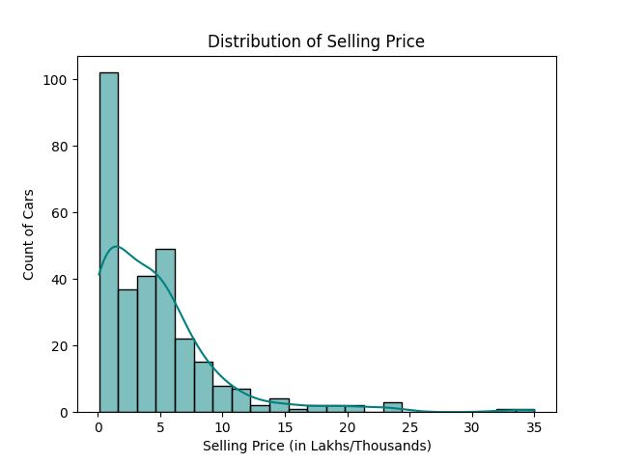
Selling Price Distribution
Finding No -1
Right-skewed distribution - most cars cluster in the ₹0-2L range, with a long tail out to ₹35L.
Median (₹3.60L) sits well below the mean (₹4.66L) - a small number of high-value listings pull the average up.
Implication: benchmark typical pricing against the median, not the mean.

Slide 7
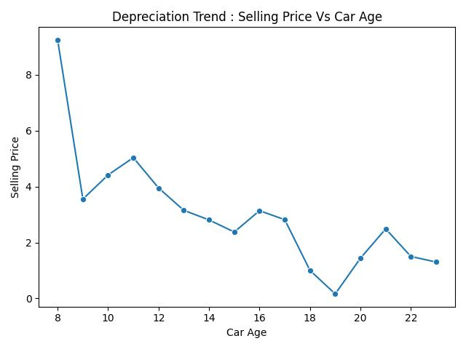
Depreciation Trend by Car Age
Finding No -2
Price falls from ~₹9.3L at 8 years old to under ₹1L by 18–19 years - the expected depreciation curve.
The trend gets noisy past 15 years - each age bucket has very few listings, so late-life upticks (e.g. age 21) likely reflect a handful of well-kept or rare cars, not a market reversal.
Recommendation: treat age-based pricing beyond ~15 years as low-confidence given sample size.

Slide 8
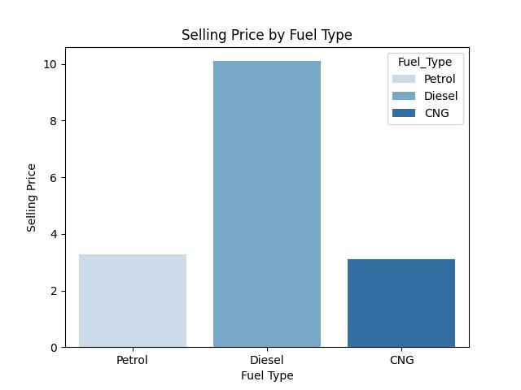
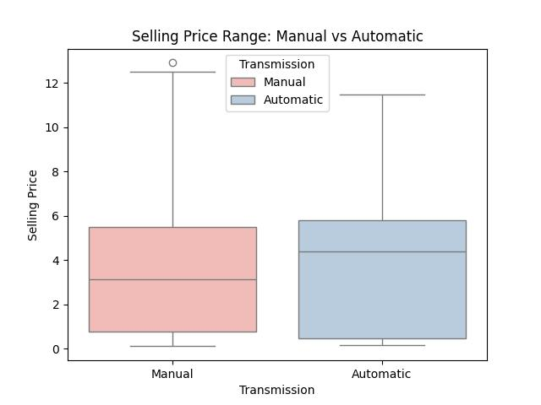
Fuel Type &Transmission Premium
Finding No -3
Diesel cars average ~₹6.9L vs ~₹3.0L (Petrol) and ~₹3.1L (CNG) - more than double.
Automatic transmission adds a premium within Petrol (₹4.0L vs ₹3.0L manual).
Caveat: no diesel or CNG automatics exist in this dataset - this reads fuel type, not transmission, in isolation.

Slide 9
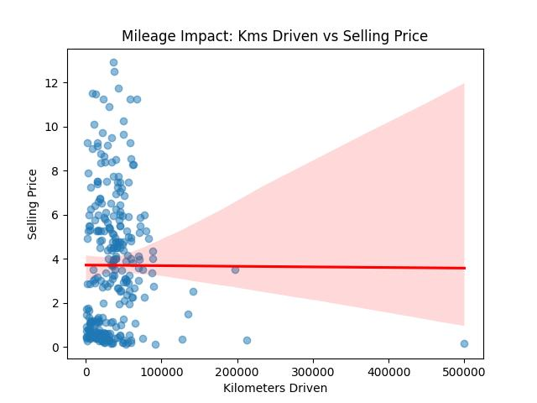
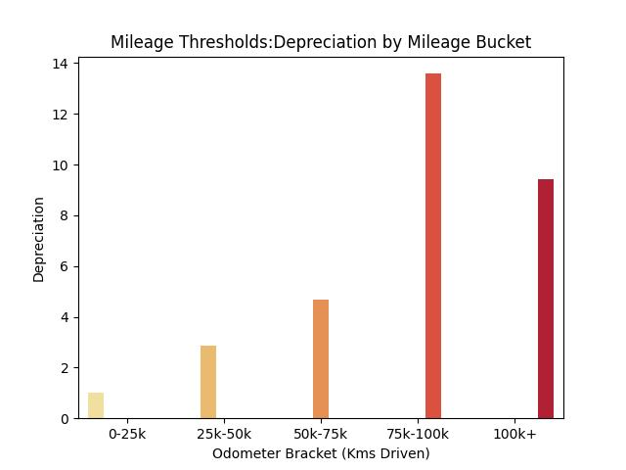
Mileage: A Weaker Predictor Than Expected
Finding No - 4
Kms Driven vs Selling Price correlation is ≈ 0.00 - raw mileage barely moves price in a straight line.
But depreciation rises steadily across mileage buckets (0–25k → 75k–100k) - the relationship is non-linear, not absent.
One 500,000 km outlier distorts the raw scatter; bucketed mileage is the safer lens for pricing.

Slide 10
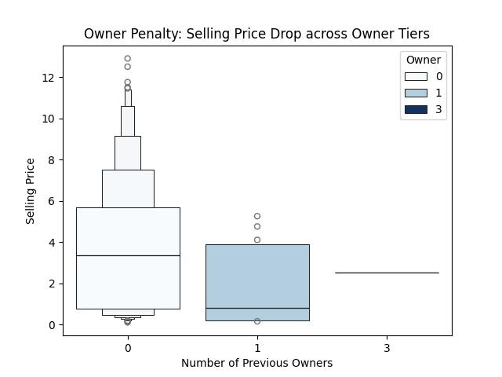
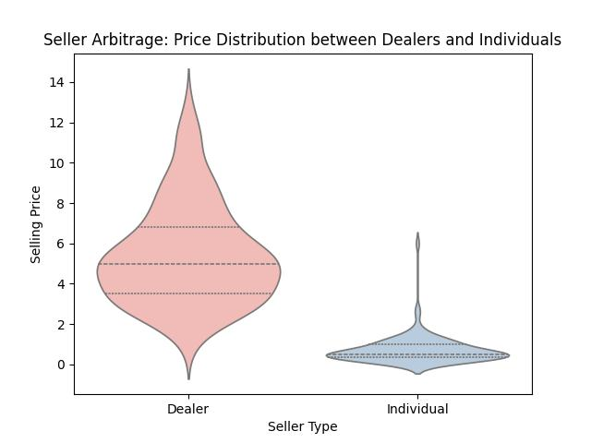
Ownership History & Seller Type
Finding No - 5
Zero-owner cars (96.3% of listings) show a much higher median price and wider upside than 1-owner cars.
Seller type is the sharpest split in the data: Dealer median ₹4.98L vs Individual median ₹0.51L - roughly 10x.
That gap is likely a quality-tier proxy (dealers stock newer/premium cars), not a standalone “dealer markup” effect.

Slide 11
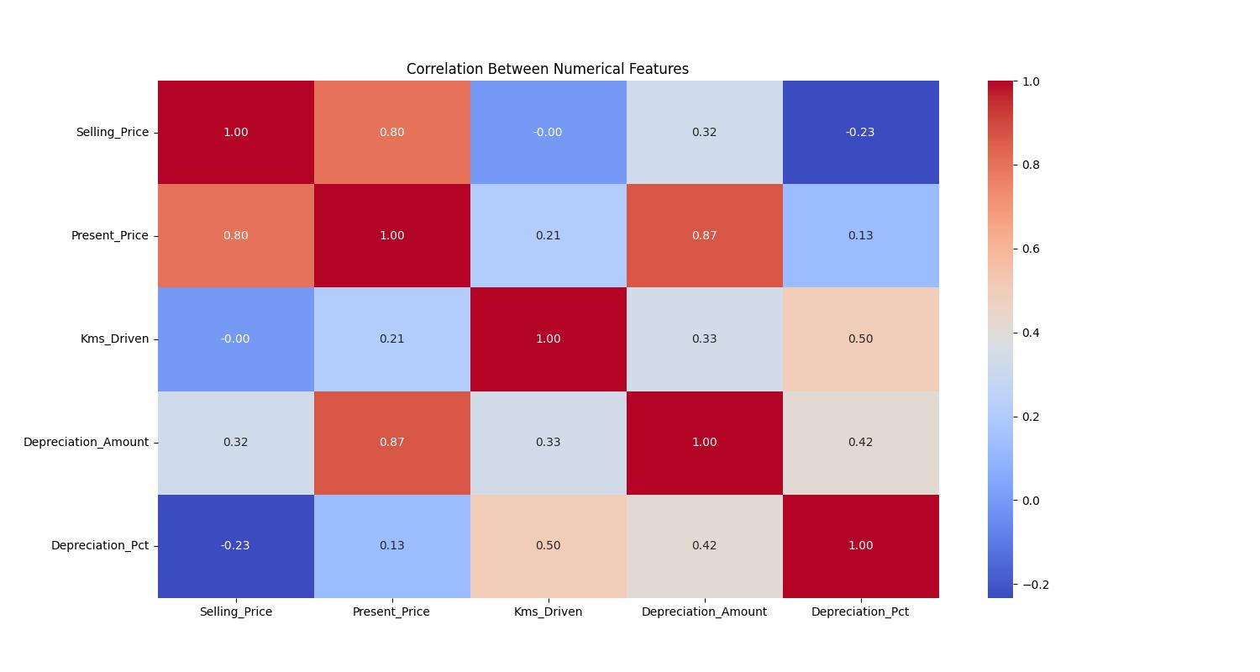
What Actually Correlates with Price
Finding No - 5
Present Price is the strongest single predictor; mileage predicts % depreciation better than it predicts raw price.
Correlation Readouts :
Present_Price -> Selling_Price 0.80
Depreciation_Amount -> Selling_Price 0.32
Kms_Driven -> Depreciation_Pct 0.50
Kms_Driven -> Selling_Price -0.00

Slide 12
Thank you
Demo Link - Click it
.

